Slide 1


OpenADR 2.0 Multiple Transport
Reference Architecture
Summer 2012 EOSP Argonauts Team
Presented by
Siddharth Subramanian
Matthew Lenzo
Notes:
A very good afternoon to everyone. My name is Siddharth and for this EOSP, Matt and I will be representing the Argonauts team.

Slide 2
Agenda
Team
Project
Progress
Approach
Roadmap
Notes:
These are the topics that we are going to focus on. I’ll briefly introduce the team and project to the audience. I’ll then shift gears to progress. I’ll start off with the approach section and Matt will take it from there all the way up to the roadmap for the future.

Slide 3





Argonauts Team
Siddharth Subramanian
Team Lead
Matt Lenzo
Quality Assurance Lead
Rui Li
Chief Architect
Dandan Zheng
Development Lead
Tharanga Gamaethige
Planning Manager
Notes:
- This is my team that comprises of Tharanga, Rui, Matt, Danny, and myself.

Slide 4



Studio Mentors
Grace
Lewis
Mel Rosso-
Llopart
Bradley
Schmerl
Notes:
And these are the mentors who have been constantly guiding the team since Fall-2011. They are Grace, Mel, and Bradley

Slide 5

Client – EnerNOC, Inc.
A leading provider of energy management
applications for the smart grid
www.enernoc.com
Jake Thompson
Mgr. of Advanced Technology
EnerNOC, Inc.
Notes:
This is our client, EnerNOC. They are into the energy management domain and we are doing a project for the advanced technology division which is a forward looking group searching for new, advanced, and innovative solutions to energy management

Slide 6
Notes:
Well, what’s this? This represents a blackout that happened in India last week due to grid overloading. Such blackouts will possibly continue to happen in the future if active steps are not taken to tackle increasing electricity demands. Unfortunately, this is just one of the many effects of increased electricity demands other than higher costs, and bigger carbon footprint that is detrimental to the environment

Slide 7

“Biggest blackout in 10 years hits India”
Notes:
Well, what’s this? This represents a blackout that happened in India last week due to grid overloading. Such blackouts will possibly continue to happen in the future if active steps are not taken to tackle increasing electricity demands. Unfortunately, this is just one of the many effects of increased electricity demands other than higher costs, and bigger carbon footprint that is detrimental to the environment

Slide 8
Project Context – Demand Response
Active steps need to be taken when there is a disparity between energy demand and energy capacity.
EnerNOC is an aggregator between utility companies and end-users.
Open Automated Demand Response (OpenADR) is a draft standard describing an information and communication model for managing end-users.
Notes:
- Active steps need to be taken for bridging the increasing gap between energy demand and energy capacity. This is where EnerNOC comes into the picture as an “aggregator” between utility companies and end-users such as large industrial, and commercial institutions. The aim of our client is to proactively manage this demand, especially when it is forecasted to exceed the capacity. - Currently, managing the assets is done manually and demand will continue to increase and more assets have to be managed. Hence, there is a need to automate this entire process. - This is where OpenADR comes into the picture. It is an open standard for managing electricity consumers such as lighting, machinery, and HVAC equipment. It is an open standard dedicated to energy management, in order to automate and control the increasing demands from these assets.

Slide 9
Project Objectives and Deliverables
Design and deliver a reference architecture for a control system in accordance with the OpenADR 2.0 standard, exhibiting “quality attributes”
Validate and demonstrate key architectural design decisions
Notes:
Keeping the need to automate management of the growing number of assets in mind , these are our project objectives and deliverables: - We are designing an architecture that represents the OpenADR standards in order to show that it works. Now, this architecture has to be evaluated and validated for quality attributes like scalability, extensibility, and performance which Matt will talk about in detail in the latter half of this presentation.
- In order to support this evaluation, we are implementing a prototype. Hence, the prototype along with the reference architecture aims at validating the “key” architectural design decisions taken by my team while designing the architecture.

Slide 10
Project Strategy
1st Semester - 2011
2nd Semester - 2012
3rd Semester - 2012
4th Semester - 2012
Sep | Oct | Nov | Dec | Jan | Feb | Mar | Apr | May | Jun | Jul | Aug | Sep | Oct | Nov | Dec
Identify, define, and refine architectural drivers iteratively
Implement a prototype to verify design decisions
Analysis, transition, and
postmortem
Create and refine architecture iteratively through feedback and evaluation
“Go/No-go decision”
“Go/No-go decision”
“Go/No-go decision”
Kickoff
Sep 23
Protocol Selection
ADD*
V1.0
Core Implementation
Architecture Frozen
SOW
ADD*
*Architecture Design Document
Notes:
Now, let me walk through the high-level activities that were conducted in the last 3 semesters in order to achieve the project objectives and the necessary deliverables. Also, I will quickly give an overview of the strategy the team is planning to adopt in the upcoming fall semester for achieving the necessary objectives and results
In the first semester, we were identifying and refining the architectural drivers, so that we could understand what will be driving the project.
In the second semester, based on the architectural drivers, we came up with an architecture and we iteratively refined it through customer feedback and architecture evaluation workshops. At the end of this semester, we left with a set of issues that had to be addressed using a prototype.
In the third semester, our experiments became more concrete and we started focusing our efforts in building a prototype, in order to validate the design decisions we took in the previous semester. We also executed some tests on the prototype to prove high-priority quality attributes such as performance and scalability. We collected results and quantitatively evaluated the architecture for performance and scalability.
In the fourth semester, we will continue to prove the architecture for its feasibility and we will also conduct tests and experiments on the prototype to prove the remaining high/medium priority quality attributes. Also, our focus will be on updating the architectural design document based on concrete results of all our experiments as guidance for those who might adopt this architectural approach. It is important to note that we will change our direction and focus based on the customer’s interest in a particular section of the architecture.
So, in the big picture, this is where we currently are.
The green diamonds are the milestones we achieved on our way as a result of conducting these high-level activities, and the gray ones are those that we are planning to achieve in the upcoming fall semester. Now, let’s focus on the red diamonds that represent some critical milestones for our project. At the end of the spring semester, we had hoped to achieve a “go” decision on our architecture. However, we did not get a “go” signal as we left the semester with a set of issues that had to be addressed using a prototype. Again, in the mid of summer, we had a check-point for our architecture. The prototype we were building did give us sufficient amount of confidence in our architecture. However, the prototype wasn’t giving us the performance numbers the client wanted to achieve. Hence, it was a no-go decision again. Now, we realized that a “go” decision actually represents the final deliverable of our project, where the architecture has been sufficiently verified for the quality attributes, and enough confidence has been gained into the architecture. For our project, this is what “go” decision means in terms of architectural proof. Hence, we hope to get a go decision by the end of the project. Potential question: What if we get a no-go decision in December?

Slide 11


Summer 2012 – Semester Goals
To build a prototype to validate critical design decisions
To prove all quality attributes using the prototype
Notes:
Keeping the overall strategy in mind, these were our goals for summer 2012 semester
We wanted to develop a prototype that would help evaluate our architecture for high priority quality attributes such as scalability, extensibility, and performance.
- We also wanted to produce a reference implementation as the “golden standard” consisting of one single service and 3 protocols
- Out of these two, we could develop only the prototype and could not completely produce the reference impl. We realized that a complete “go” decision, in terms of what was explained in the previous slide is required for the reference impl. Also, the quality requirements and the process required for building a reference impl. is completely different than the ones required for building a prototype. Hence, we shifted our focus in developing a prototype first that could validate the architecture for high-priority quality attributes. We also confirmed this decision of ours with the client who also wanted the team to first verify the architecture for design decisions that were made related to the high-priority quality attributes, such as scalability and performance.

Slide 12
Summer 2012 – Earned Value (EV) Chart
May - 2012
June - 2012
July - 2012
Aug - 2012
Week 1 | Week 2 | Week 3 | Week 4 | Week 5 | Week 6 | Week 7 | Week 8 | Week 9 | Week 10 | Week 11 | Week 12
“Go/No-go decision”
Core Implementation
“Go/No-go decision”
12
Notes:
Using our current earned value chart as the medium, let me tell a story of what we actually did compared to the semester goals we had hoped to achieve. Also, let me highlight the key decisions we took through the summer semester. Our earned value is based on the work packages planned to achieve the summer goals, where work packages is defined as a set of related tasks or activites.
Decision points to consider:
As with any other software project, we were on track in the beginning.
But, soon we realized that we were running parallel to the planned value, and this is when we realized that we won’t be able to verify all the quality attributes that we had initially planned to verify.
Then we re-planned because of which you can see this slight bend. We re-planned to pull architectural verification activities earlier, and we also started building core.
We slipped a bit because there was a learning curve involved in learning new technologies such as Spring framework which the client wanted incorporated in the project. We then soon caught up with our plan.
- We soon ran into problems when we started integrating and testing our prototype modules. This was because we did not consider configurability/testing of the prototype when we were building it. These became integration problems when getting components together for testing. Also, testing a large system in a cloud environment was new to the team.
- And finally, the most interesting part of the earned value; the flat line in the last two weeks. Here, we re-iterated our plan with the client, and they asked us to focus on scalability and performance tuning of the code. This was the reason why we had to defer work packages related to proving service extensibility and protocol extensibility. We had planned to do this is the last two weeks, but did not after getting feedback from the client. They specifically asked us to concentrate on fixing performance issues. We had initially planned to defer fixing of these issues, but the client asked us not to do it.

Slide 13
Approach
Project Management / Quality Assurance / Prototype
Project Management
Quality Assurance
Architectural Prototyping
Notes:
Now, let’s shift our focus to everyone’s favorite section – Project Management

Slide 14
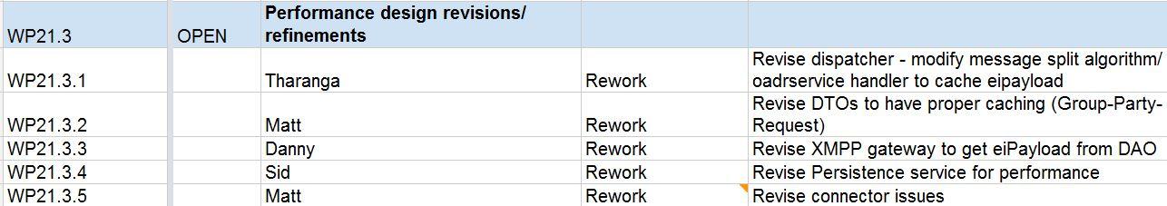
Planning, Estimation, and Tracking
Project Management / Quality Assurance / Prototype
Notes:
- We populated our plan by first looking at the earned value. We generated work packages in order to achieve the summer goals, and as mentioned before, a work package is a set of related tasks. This is an example of a work package planned to be completed in a certain iteration. As you can see, it consists of a set of related tasks. Every task has a corresponding number assigned to it which we had setup for tracking purposes, and also to help us gather data on it.

Slide 15
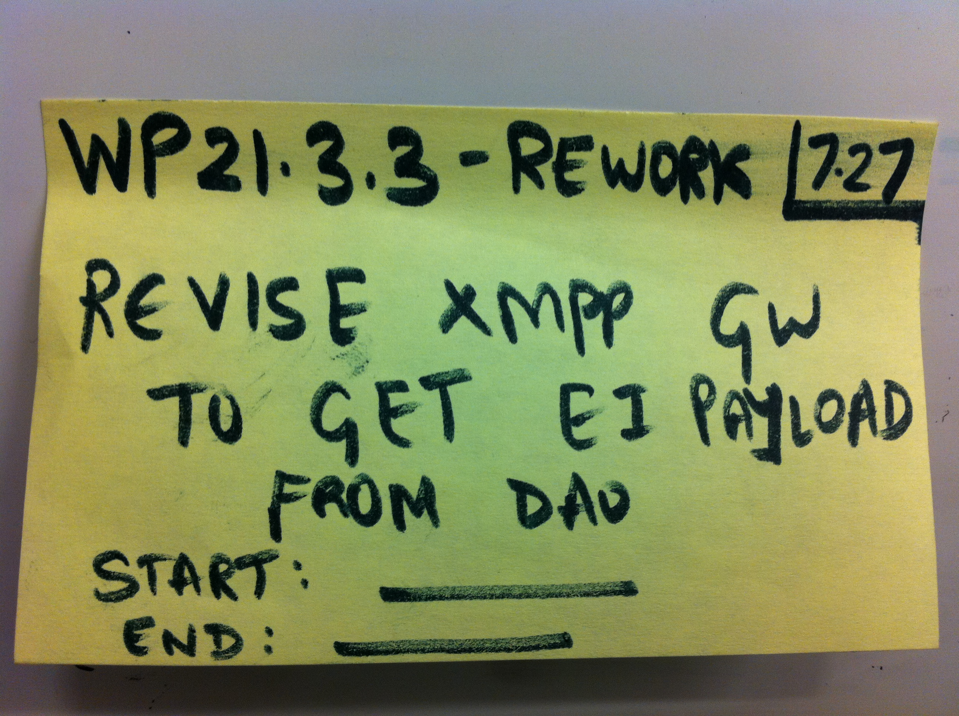
Planning, Estimation, and Tracking
Project Management/ Quality Assurance/ Prototype
Notes:
Now, let me show you an example of a particular task taken from the work package example that I just showed.
As compared to the spring semester, we changed the way in which we were planning and tracking our daily activities. Since we were building a prototype, our construction and detailed design activities were more concrete. Hence, we decided to plan and track the tasks at a more granular level. We broke down tasks up to a level of 1 person day effort.
- After breaking down the tasks to a sufficient level of granularity, we estimated them using the 3-point estimation technique as we felt that it aligned with the granularity of the tasks. However, before estimating, we discussed the scope, entry criteria, and exit criteria of each task and then every team member independently came up with an estimate.
- We have some reflections related to planning in general.

Slide 16
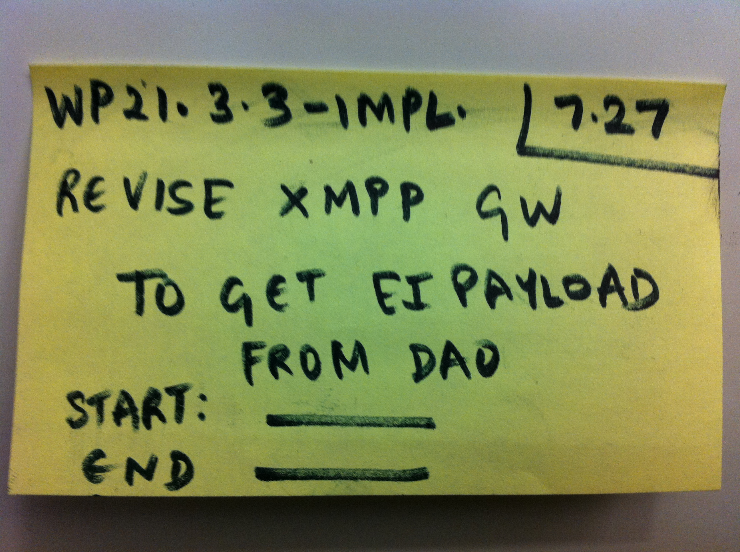
Planning, Estimation, and Tracking
Project Management / Quality Assurance / Prototype
8 person- hours as the sweet spot.
We meticulously gathered data, but did not fully use it to our advantage.
Notes:
Planning reflection: While planning, finding the sweet spot between insufficient granularity of tasks and excessive granularity of tasks is very important. In our case, a task estimated at 1 person day effort was the sweet spot that we found. It was the appropriate level of granularity that we wanted to achieve.
Metrics reflection: We had perfectly set ourselves up for collecting data on tasks and work packages. However, we did not fully leverage the various data that we gathered.

Slide 17
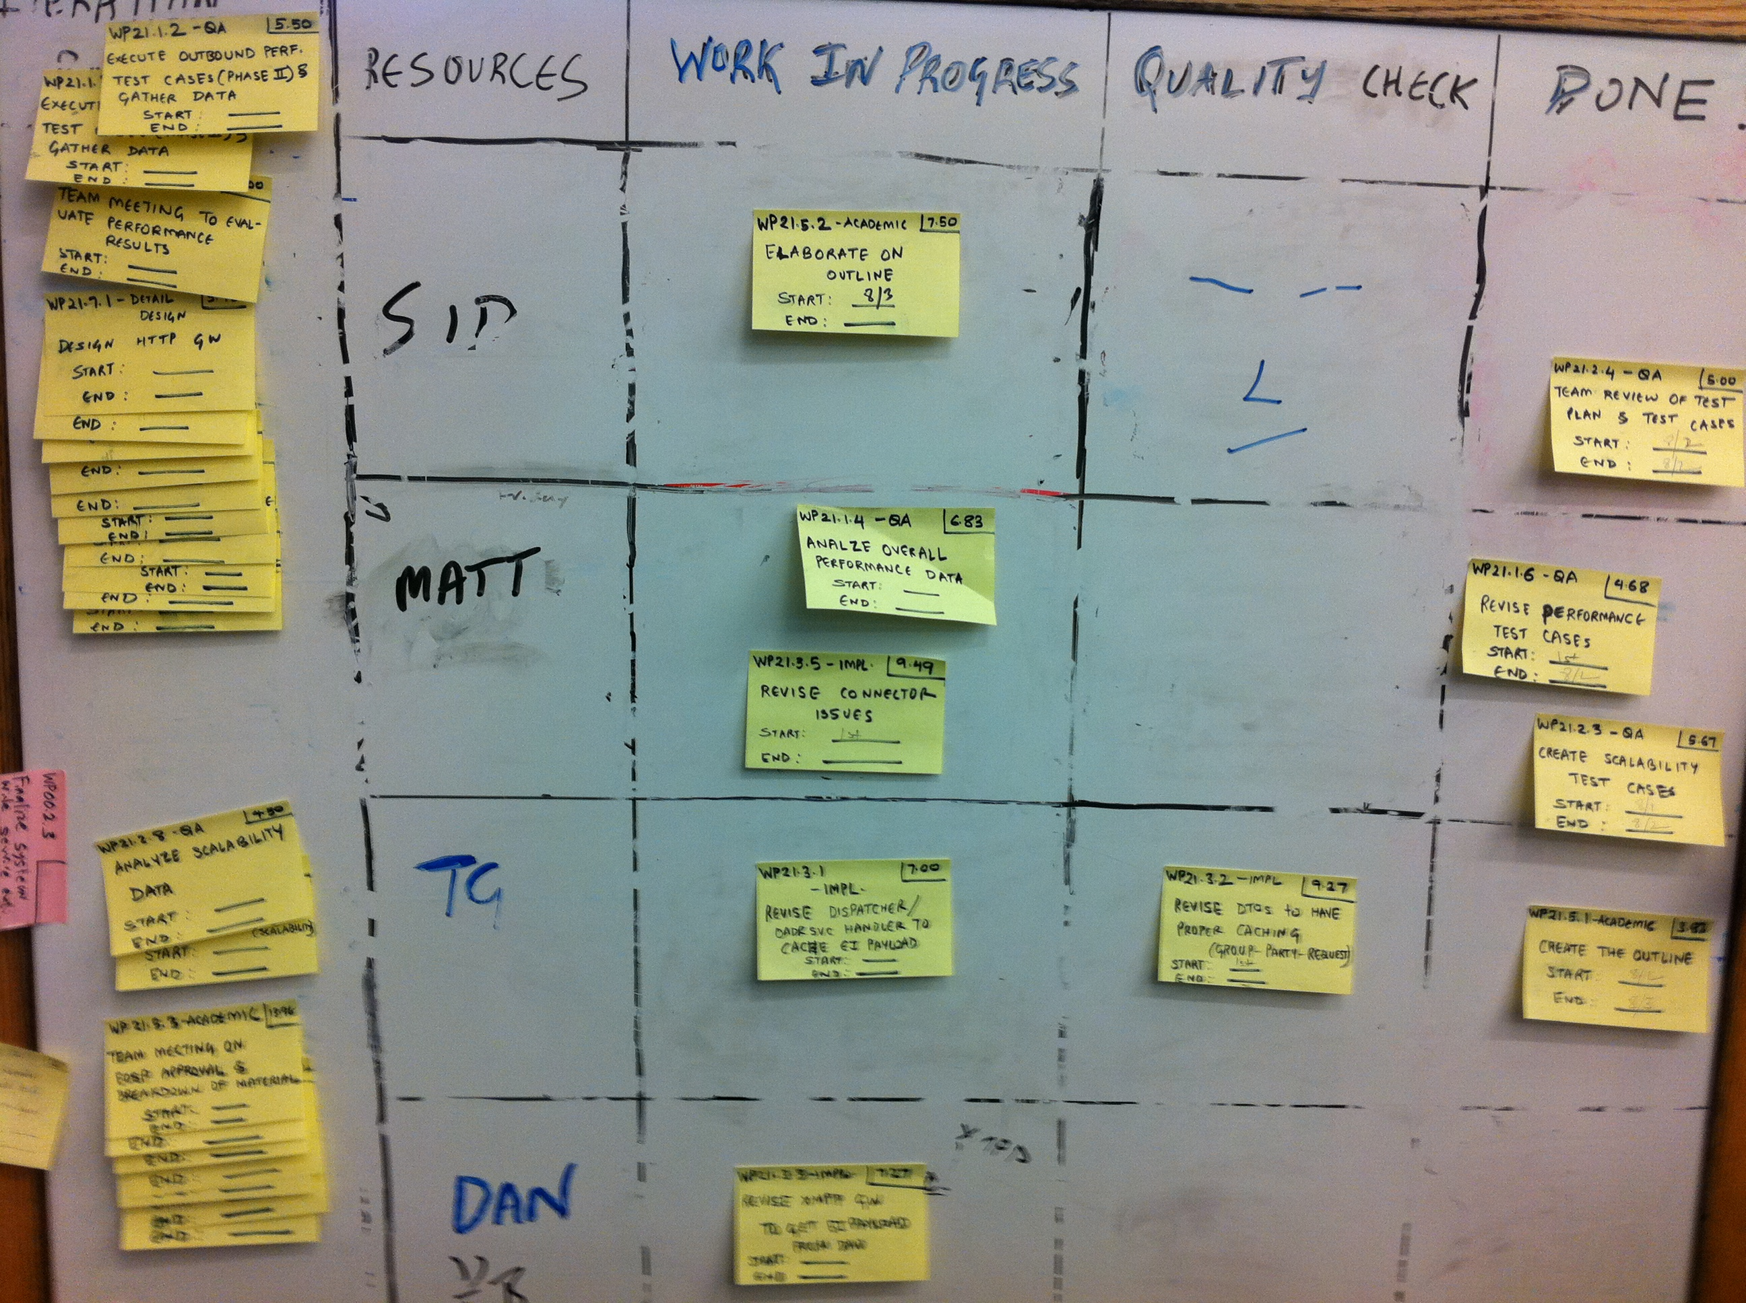
Planning, Estimation, and Tracking
Project Management / Quality Assurance / Prototype
- Objective status of tasks
- Resource leveling
Notes:
- After planning and estimating, we used to track our daily activities using this task board that represented the activities that were being carried out in a particular iteration, along with the resource that was working on the task.
Tracking reflection:
This task board objectively represented the tasks that were in progress, the tasks that were being verified, and the tasks that were completed. Also, it greatly helped us in the process of resource leveling, as we could visually see which resource was overloaded with work and which resource was free to take up tasks.

Slide 18
Planning, Estimation, and Tracking
Project Management / Quality Assurance / Prototype
Coordination problems and challenges during weekends.
Notes:
We had also tracked our iteration activities using a burn-down chart. This is an example of a burndown. The reflection we have here is that that coordination was difficult and challenging during weekends, and tasks were not getting completed during weekends

Slide 19
Top 3 Risks – End of Summer 2012
Project Management / Quality Assurance / Prototype
Condition | Consequence | Mitigation Strategy
Verifying systemic properties, such as performance and scalability took much more time to complete, as compared to the estimated time. | We may not be able to verify all the systemic properties by the end of the project. | Re-scope the verification of the systemic properties with the client. Plan, and setup the testing infrastructure in advance.
There is a substantial gap between existing performance numbers of the persistence service, as compared to the required performance numbers. | We may not have an architectural design that meets the performance requirements of the client. | Allocate dedicated resources for the performance tuning of the persistence service. Leverage client’s experience
Not all use cases were taken into consideration when coming up with the test cases. | All functional requirements of the system may not be verified. | Re-prioritize functional requirements with the client. Add and map test cases for the required functionalities.
Notes:
Current top 3 risks in the form of condition, consequence and the mitigation strategies planned.

Slide 20
Approach
Project Management / Quality Assurance / Prototype
Project Management
Quality Assurance
Architectural Prototyping
Notes:
Introduce self – played role of Quality Assurance Lead this semester

Slide 21
Quality Attributes
Project Management / Quality Assurance / Prototype
Priority | Quality Attribute | Business Driver
HIGH | Scalability | Expand into untapped Demand Response markets
HIGH | Protocol Extensibility | Encourage adoption by supporting different protocols
HIGH | Service Extensibility | Accommodate evolution of the OpenADR standard
MED | Performance | Support aggressive real-time programs
MED | Cloud Deployability | Exploit commodity hardware on the cloud
Other Attributes: Confidentiality, Fault Tolerance
Notes:
Should re-emphasize that we are delivering a design for a Demand Response system
OpenADR is NOT a design; it’s a communication model describes the semantics of energy information exchange
We need to consider the requirements of practical Demand Response:
Scalability: How to expand into untapped markets – residential and commercial assets number 1,000’s or millions.
Extensibility: How to accommodate evolution of the OpenADR standard itself
Performance: How to support aggressive real-time programs?
Shopping list doesn’t end there: Security, fault tolerance and reliability – all very real requirements for intended operational environment
These quality attributes prioritized by customer according to their concerns and interests

Slide 22
Primary Quality Assurance Activities
Project Management / Quality Assurance / Prototype
Objective: Produce evidence that the architecture will exhibit the desired qualities, identify “architecture breakers” early, and fill “architectural gaps”
Scalability
Use Asynchronous Connectors
Avoid Distributed Transactions
Small Unit of Work
Redundant Hosting
System Throughput
Design Decisions
Evidence
Notes:
If we are delivering a design that can achieve these quality objectives, we are also delivering some degree of confidence in our design decisions.
Fact of the matter: drawing boxes and arrows all last semester and reasoning through alternatives with the client: we’ve exhausted our collective experience and intuition – need to buy more confidence
Formal methods vs. coding – client’s choice
“quality assurance” primarily means producing hard evidence that design decisions are sound
Looking for architecture breakers – gotchas that might send entire design document to recycle bin
Looking for architectural gaps – have we provided enough guidance where it gets tricky?
Consider scalability
Number of patterns we’ve applied across the system – do they work?
Queues everywhere – can we maintain throughput adding 10,000, 100,000, 500,000 1,000,000 assets in DR network?

Slide 23
Defect Classification
Project Management / Quality Assurance / Prototype
Architectural Defects: Fundamental issues with the high-level design (or lack thereof) which may prevent system from achieving desired qualities
Other Defects: Issues with artifacts, processes, or tools which prevent successful completion of primary assurance activities
RabbitMQProducer.java
Memory Leak
Origin
Code Defect
Activity
Testing
Impact
Performance
Impacts Scalability
Impacts Performance
Impacts Protocol Extensibility
Impacts Service Extensibility
Impacts Deployability
Impacts Fault Tolerance
Notes:
Brings us back to reality: What do we do when we produce evidence to the contrary?
Can’t hit that performance target
Can’t add a new service without ripping out half the framework
If originated with an architectural decision or lack of decision – then consider that an architectural defect
What about other defects – prototype code, test harness, configuration - two options:
1. Ignore them. Afterall, prototype shouldn’t become product.
2. Manage them. Truth is – become show-stoppers during assurance activities
In Github’s issue tracker, developed a simple taxonomy:
How classified Impact: How does defect impact desired qualities or demonstration of qualities?
Let me give an example how we used this information:
Conducting performance test, noticed a memory leak in connector – couldn’t execute test cases.
1. Leveraged customer’s experience: regularly comment on “show-stoppers”
2. Helped prioritize fixes and help identify if and when something gets fixed

Slide 24
Secondary Quality Assurance Activities
Project Management / Quality Assurance / Prototype
Objective: Ensure the validity and sufficiency of architectural evidence as well as supporting processes and tools
Activity | Usefulness
Peer Reviews
Detailed Design Reviews
Unit Testing
Integration Testing
Smoke Testing
Notes:
Because we chose to manage defects, needed some filters in place – constituted secondary quality assurance activities
Guess you can say that they help prevent us from tainting all the architectural evidence
Original quality assurance plan – budgeted for many activities, but paired down to five essential:
Naturally, these activities will change as the project winds down and focus is on documenting state of architecture
Team rated each activity according to its usefulness from 1 – 5 –
Smoke testing: Lengthy tests on amazon – expensive to execute
Smoke test to ensure no “show-stoppers” (under load, system exhibit different behavior)
Test data is correct and useful
Test team knows how to deploy and execute the system (lots of configuration)
Attest to difficulty pulling things down from cloud

Slide 25
Approach
Project Management / Quality Assurance / Prototype
Project Management
Quality Assurance
Architectural Prototyping
Notes:
Switch gears here for a second – talk about process of prototyping for the purposes of producing architectural evidence.

Slide 26
Architectural Prototyping
Project Management / Quality Assurance / Prototype
Quality
Attribute
What quality or design do we want to verify?
Test
Strategy
How will we verify it?
What components are required?
What is the minimum functionality required?
Code
What technologies will we use?
What is a possible design for each component?
Does the architecture provide enough guidance?
Notes:
Let our quality attribute scenarios – specifically the response measures and conditions drive our verification strategy
The priorities of the quality attributes helped guide our decisions on what to tackle first
When coming up with a strategy, need to identify which components need to be developed
More importantly, to what extent do they need to be built?
Narrow set of functionality that will satisfy the test path
Demonstrate interesting architectural decisions, not much else
Need to consider future testing activities, might not need component now, but need it later
Lastly, step through process a developer would follow
Select appropriate technologies or approaches
How might the architecture be realized
Did some pathfinding for our client – interested in using Spring, Object-Relational-Mapping

Slide 27
Architectural Prototyping
Project Management / Quality Assurance / Prototype
Front-End Tier
Outbound Target:
200 Messages / second
Legend
Front-End
Client
HTTP/REST
Application Tier
A
B
OADR Application
Service Provider
Message queue
(A queues message for B)
Persistence Tier
A
B
A reads data from B
Routing Tier
Dispatch Service
A
Protocol-specific message
(A sends a message out)
Process
Transport Tier
Runtime tier
HTTP
XMPP*
AMQP
Runtime tier
(overlay mapping)
* Extensible Message and Presence Protocol
Notes:
Let me give an example – as close to demo as possible
What you see here is dynamic view of our system – specifically illustrating message handling on outbound path
From the application tier a single message can be dispatched to 100’s, thousands, or tens of thousands of recipients over multiple protocols
From our quality attribute scenarios: need to sustain a throughput of 200 messages / second at the gateway highlighted in green
Several design decisions at stake:
Segregated expensive database write operations from the outbound path
Using message queues to allow each component to scale independently – correct topology?
Caching policy used in each component
Dispatch algorithm used to split messages according to outbound protocol

Slide 28
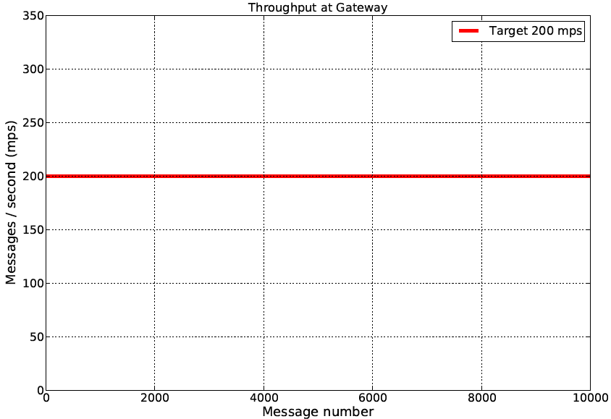
Architectural Prototyping
Project Management / Quality Assurance / Prototype
Core
Transport
Legend
Module
Not constructed
Configuration
XMPP
AMQP
HTTP
A
B
Layer
Constructed
Gateway API
A allowed
to use B
Error
Log
Routing
Dispatch Svc.
Connector
Persistence
Message
Persistence Svc.
OpenADR Services
Facade
Data Access
Handlers
Cache
Framework
Datamodel
Notes:
Look at a simplified static view of the architecture:
Somehow these modules have to work together to meet this goal
What do we build first?
How much of each component?

Slide 29
Architectural Prototyping
Project Management / Quality Assurance / Prototype
Core
Transport
Legend
Module
Not constructed
Configuration
XMPP
AMQP
HTTP
A
B
Layer
Constructed
Gateway API
A allowed
to use B
Error
Log
Routing
Dispatch Svc.
Connector
Persistence
Message
Persistence Svc.
OpenADR Services
Facade
Data Access
Handlers
Cache
Framework
Datamodel
Notes:
Fashioned the building blocks we would need to construct more of the system
Core was concentration of technologies related to (all required to meet performance / scale objectives)
Message serialization
Connectors
Data access to persistence tier
Caching
One of our first performance tests were on our connectors themselves
Found that we needed more throughput
Implemented connection and channel pooling to get those numbers up

Slide 30
Architectural Prototyping
Project Management / Quality Assurance / Prototype
Core
Transport
Legend
Module
Not constructed
Configuration
XMPP
AMQP
HTTP
A
B
Layer
Constructed
Gateway API
A allowed
to use B
Error
Log
Routing
Dispatch Svc.
Connector
Persistence
Message
Persistence Svc.
OpenADR Services
Facade
Data Access
Handlers
Cache
Framework
Datamodel
Notes:
Used blocks to build other components
Small unit of work pattern meant functionality already limited – even more limited subset
Only required one gateway for the outbound path: client interested in this protocol

Slide 31
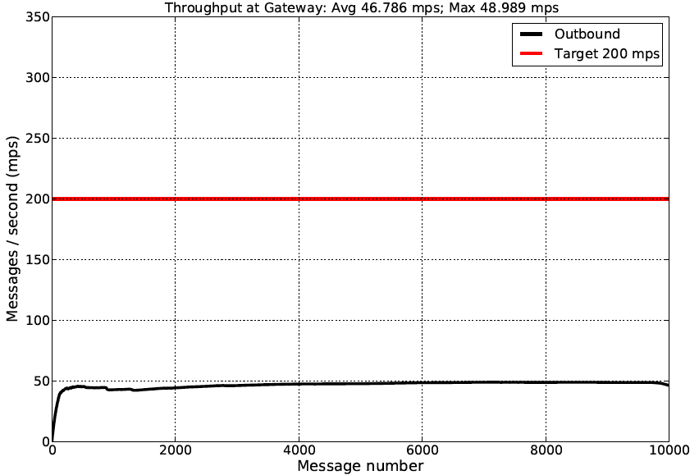
Architectural Prototyping
Project Management / Quality Assurance / Prototype
Core
Transport
Legend
Module
Not constructed
Configuration
XMPP
AMQP
HTTP
A
B
Layer
Constructed
Gateway API
A allowed
to use B
Error
Log
Routing
Dispatch Svc.
Connector
Persistence
Message
Persistence Svc.
OpenADR Services
Facade
Data Access
Handlers
Cache
Framework
Datamodel
Notes:
After integration, ran first test : 50 messages per second – well off from where we wanted to be. – Why?
Analysis of results with client, who had some insights into the matter.
Architecture didn’t specify the caching behavior in enough detail to use it properly
Dispatch algorithm was inappropriate for the message pattern in the system
Serializing too much information, think carefully about where it is really needed

Slide 32
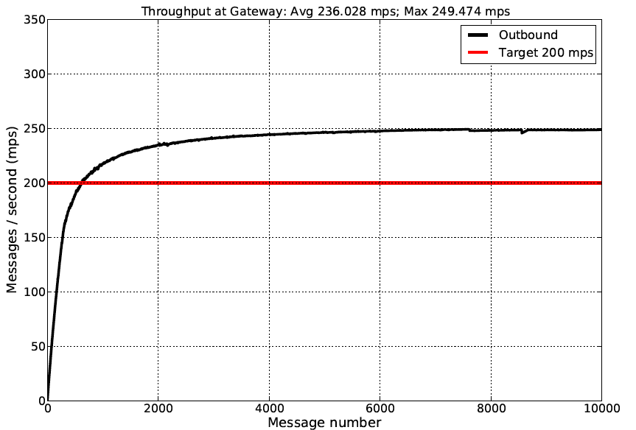
Architectural Prototyping
Project Management / Quality Assurance / Prototype
Core
Transport
Legend
Module
Not constructed
Configuration
XMPP
AMQP
HTTP
A
B
Layer
Modified
Gateway API
A allowed
to use B
Error
Constructed
Log
Routing
Dispatch Svc.
Connector
Persistence
Message
Persistence Svc.
OpenADR Services
Facade
Data Access
Handlers
Cache
Framework
Datamodel
Notes:
Revised select components – equated to architectural decisions
Re-ran test suite and managed to achieve the quality attribute’s test objectives

Slide 33
Prototyping Reflections
Project Management / Quality Assurance / Prototype
Reference Implementation vs. prototype
Look past the code. What does it say architecturally?
Architectural decisions are often confirmed at the keyboard.
Prototypes require additional design considerations:
Testability: How will it be instrumented?
Configurability: What is tunable and how should it be tuned?
Evolveability: Throw-away or re-use, but plan accordingly.
Notes:
Reference implementation is not a prototype
Very different quality processes involved in the development of something that is more like a “golden standard”
More importantly, requires architectural certainty
Look past the code
When writing code, kept quality attributes in mind; definitely saw architecture manifest at the code level.
Mentioned ran into integration problems: slowed down test process – why?
Testability
Configurability
Evolveability

Slide 34
Status of Architectural Verification
Priority | Quality Attribute | Evidence | Status
HIGH | Scalability | Fair queuing and consumption | Verified
 |  | Maintains outbound performance | Verified
 |  | Maintains inbound performance | In Progress
 |  | Data scale and consistency | Not Verified
HIGH | Protocol Extensibility | Implement three gateways | In Progress
HIGH | Service Extensibility | Implement two services | Not Verified
MED | Performance | Outbound throughput | Verified
 |  | Outbound latency | Verified
 |  | Inbound throughput | In Progress
 |  | Inbound latency | In Progress
MED | Cloud Deployability | Launch and configuration time | In Progress
Notes:
Where are we right now:
We’ve got prototype code that resembles our architecture: need this to move forward with other tests
Tackled some of the most uncertain and risky technical verification activities first
Customer has focused us on performance and scalability right now
Take another look at extensibility afterwards

Slide 35
Fall 2012 Roadmap
September
October
November
December
1 | 2 | 3 | 4 | 5 | 6 | 7 | 8 | 9 | 10 | 11 | 12 | 13 | 14 | 15 | 16
Verification
Scoped
Architecture
Frozen
Go/No-Go
Decision
Poster Session
Reflection
Paper
Package &
Delivery
Notes:
Brings us to what is going to happen next semester.
First thing: re-engage and ensure the client is aware of all the outstanding architectural issues
Requires an analysis of where we are at based on all the recent test data
At some point freeze architecture – anytime between there the client can direct our efforts to places of interest
Once architecture is frozen, analysis on the status of architecture
Take into consideration other quality attributes
Outstanding issues and risks
Take one last final decision with client with regard to confidence in design and spend remaining time packaging all artifacts

Slide 36
Team Roles – Fall 2012
Siddharth Subramanian
Quality Assurance Lead
Matt Lenzo
Chief Architect
Rui Li
Development Lead
Dandan Zheng
Planning Manager
Tharanga Gamaethige
Team Lead
Thank you!

Slide 37
Backup

Slide 38
Acceptance Criteria
An architecture that supports XMPP, HTTP, and AMQP transports
An analysis of scalability and performance thresholds
A reference implementation appropriate for demonstrating and verifying key architectural qualities
Well-documented design rationale

Slide 39
Client Feedback
Positive Feedback..
“You guys are putting in a great effort! Although, it is clear that you’re using a lot of these technologies for the first time. That’s ok, we’re here to help guide you in the right direction.”
“We’re thrilled that the team is seeing good progress.. “
Improvements to be made..
“You were very receptive to feedback during scheduled meetings, but between meetings it is helpful to get updates on progress and issues encountered during development.”
“Maybe you felt like all of that up-front planning was necessary or maybe it was a required part of the course but for us it meant less time working on the code and the metrics, which are the most important deliverable.”

Slide 40
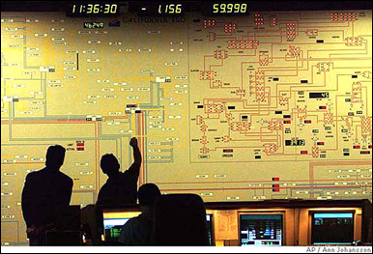





Project Context – Demand Response
1
Demand Response Event
Peak energy usage
Emergency curtailment
Utility/Grid Operator
2
Notification
Execute Energy Reduction Plans
3
Industrial
Institutional
Commercial
Feedback
4
Notes:
- Our system will reside with energy aggregators, such as EnerNOC to handle notification and feedback

Slide 41

Project Scope – Automated Demand Response
Feedback
Notification
VEN
Lighting
HVAC
<OpenADR 2.0 />
Machinery
Virtual Top Node
(EnerNOC)
Virtual End Node (Customer)
1,000 Nodes
Large Industrial
Business Goals
Untapped demand response markets
Lower implementation costs
Real-time monitoring and control
100,000 Nodes
Small Commercial
1,000,000 Nodes
Residential
Notes:
- Project scope is denoted by the grey dotted box

Slide 42
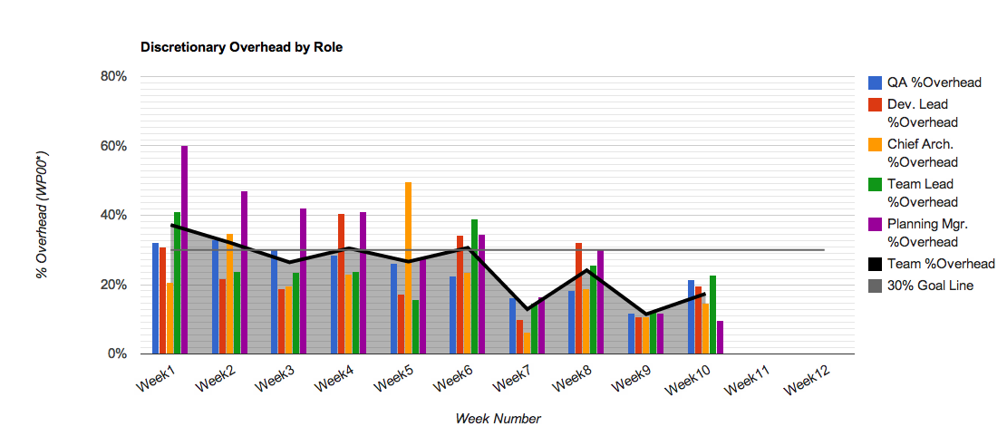
Overhead

Slide 43
Week 1
Point value
Week

Slide 44
Week 2
Point value
Week

Slide 45
Week 3
Point value
Week

Slide 46
Week 4
Point value
Week

Slide 47
Week 5
Point value
Week

Slide 48
Week 6
Point value
Week

Slide 49
Week 7
Point value
Week

Slide 50
Week 8
Point value
Week

Slide 51
Week 9
Point value
Week

Slide 52
Week 10
Point value
Week

Slide 53
Week 11
Point value
Week

Slide 54
Week 12
Point value
Week

Slide 55
Iteration 12 Burndown
Hours

Slide 56
Iteration 13 Burndown
Hours

Slide 57
Task Relative Error

Slide 58
Average Task Relative Error

Slide 59
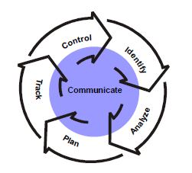
Risk Management Process
Requirements / Design / Management / Quality / Risk
Identification
Format: Condition + Consequence
Mini Team SRE (Software Risk Evaluation)
Analyze
Matrix of impact and probability
Prioritized through multi-voting
Plan
Mitigation strategy for top 3 risks
Track
Risk Manager reports risks bi-weekly
Risk repository
Control
Before iteration planning, reevaluate risks
Create mitigation tasks in backlog
SEI Continuous Risk Management

Slide 60
Top 3 Risks – Beginning of Summer 2012
Condition | Consequence | Mitigation Strategy
Transport-level security decisions not yet finalized in the OpenADR specification | May not finalize architecture design without addressing security | Continuous communication with customer on specification Isolate transport security components to enable future modifiability
Team will use Amazon Web Services for architecture verification; design mistakes can cost money | Team may deplete test budget | Define the budget before doing verification on AWS and continuously monitor actual cost against budget Test approval process
No hands-on experience with large-scale systems and detailed knowledge of transport protocols | May not deliver multi-transport architecture | Protocol extensibility experiments (half done) Short and iterative design
Notes:
- Status of the top 3 risks that were shown in Spring EOSP - What did we do to mitigate the top 3 risks.

Slide 61
Status of Risks over the Summer 2012
Number
Of
Risks
Week

Slide 62
Performance Test – Phase II
Test Id | Event Count | VEN Count | Message Count | Avg Throughput Out | Avg Latency Out | Avg Throughput In
T2 | 1 | 100 | 100 | 51.024 m/s | 0.964 s | 2.294 m/s
T3 | 1 | 500 | 500 | 169.401 m/s | 1.361 s | 3.774 m/s
T4 | 1 | 1000 | 1000 | 205.793 m/s | 2.221 s | 4.552 m/s
T5 | 2 | 1000 | 2000 | 201.674 m/s | 2.519 s | 5.257 m/s
T6 | 1 | 2500 | 2500 | 225.368 m/s | 5.195 s | 5.558 m/s
T7 | 2 | 2500 | 5000 | 238.845 m/s | 7.778 s | 6.145 m/s
T8 | 1 | 5500 | 5500 | 234.118 m/s | 11.251 s | 6.341 m/s
T9 | 1 | 7500 | 7500 | 235.807 m/s | 15.241 s | Too slow
T10 | 1 | 10000 | 10000 | 236.028 m/s | 20.356 s | Too slow
T11 | 2 | 10000 | 20000 | 241.282 m/s | 28.319 s | Too slow
T12 | 1 | 25000 | 25000 | 233.787 m/s | 51.465 s | Too slow
T13 | 2 | 25000 | 50000 | 238.801 m/s | 99.368 s | Too slow

Slide 63
Performance Test – Phase II
Test Id | Event Count | VEN Count | Message Count | Avg Throughput Out | Avg Latency Out | Avg Throughput In
N | 1 | 75000 | 75000 | 235.021 | 153.443 | Too slow
O | 1 | 100000 | 100000 | Skipped | Skipped | Skipped
P | 2 | 100000 | 200000 | 233.840 | 409.791 | Too slow

Slide 64
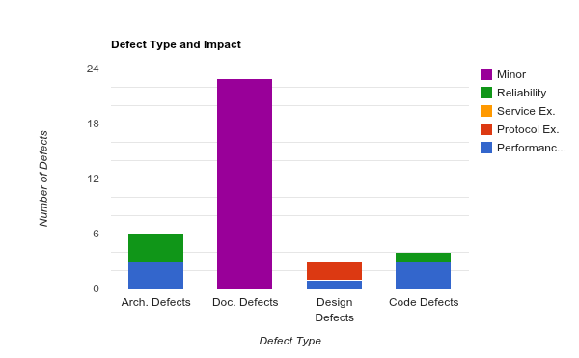
Defect Snapshot

Slide 65
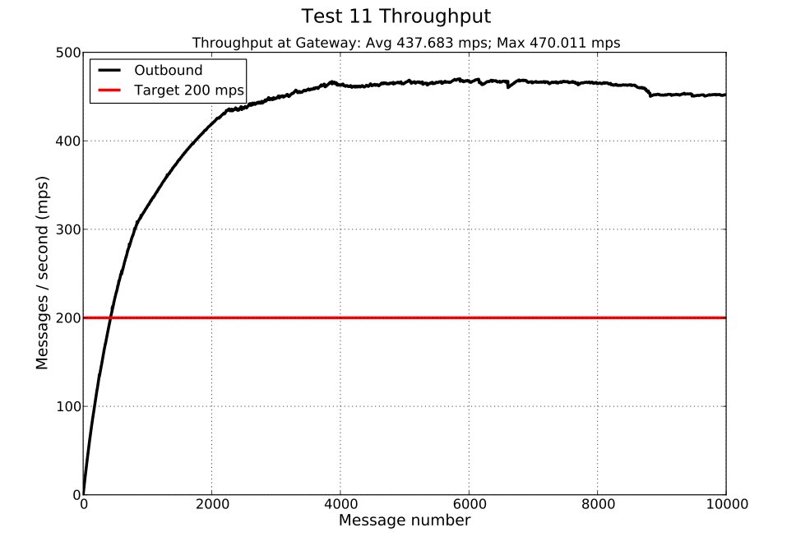
Two Dispatchers

Slide 66
Quality Activity: Detailed Design Reviews
Check conformance to architectural design
Check appropriate use of technologies and idioms
Identify “architectural gaps”

Slide 67
Quality Activity: Unit Testing
Limited to functionality required for primary assurance activities
Ensure components do not become brittle as prototype evolves

Slide 68
Test Cases Distribution
Total Test Cases: 151

Slide 69
Quality Activity: Smoke Testing
Rehearse test cases locally prior to execution on AWS
Identify “show-stoppers” (e.g., concurrency or configuration issues)
Ensure adequacy and correctness of test data and analysis tools
Ensure test team understands how to execute test plan

Slide 70
Keeping architecture and prototype in sync
Downstream
- Detail design reviews to ensure the detail designs are in sync with architecture design
- Code review to verify code doesn’t violate architecture invariants
Upstream
Implement architectural spikes to verify quality attributes
If the implementation doesn’t match with the expected output of quality attributes, refine the detail design and implementation.
If the implementation satisfies quality attributes, but deviates from the original design decisions, modify ADD to reflect the changes.

Slide 71
Changes on the proposed architecture
Modified message dispatching algorithm to enhance the performance
Modified the gateway API design for better usability and maintainability
Simplified the service handler design
Removed message receiver component

Slide 72
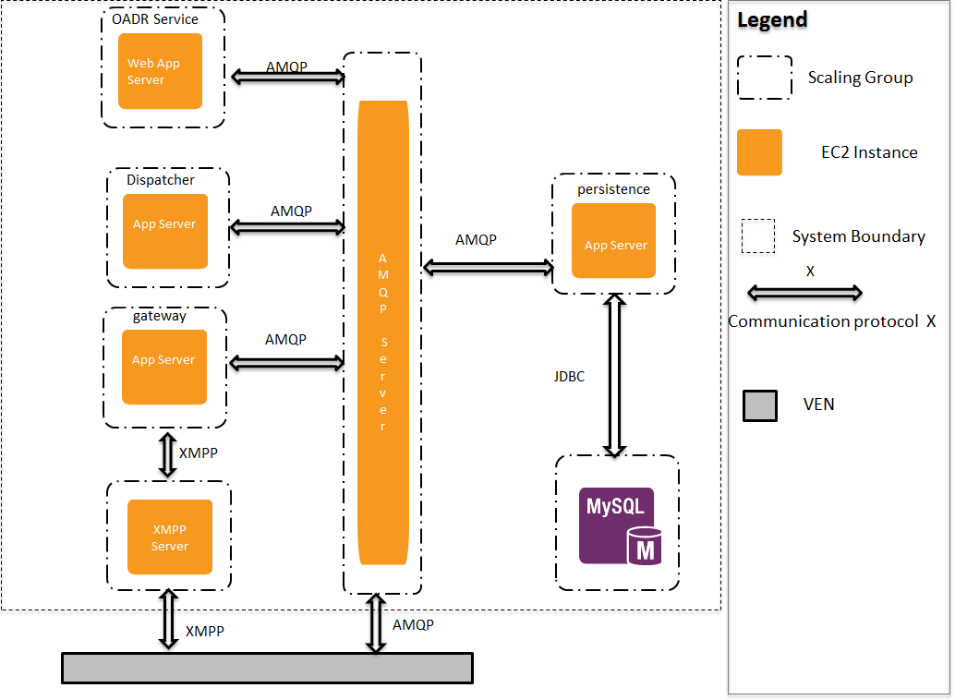
Allocation view and initial diagrams

Slide 73
Architecture Design Process
Requirements / Design / Management / Quality / Risk
Design
Peer Review
Client Feedback
Architecture Design Evaluation Workshop
Documentation and Issue Analysis
Short design iterations
Breadth first vs. depth first
Low-fidelity to higher fidelity
Notes:
Short design iterations: ensure convergence of designs and gather client feedback

Slide 74
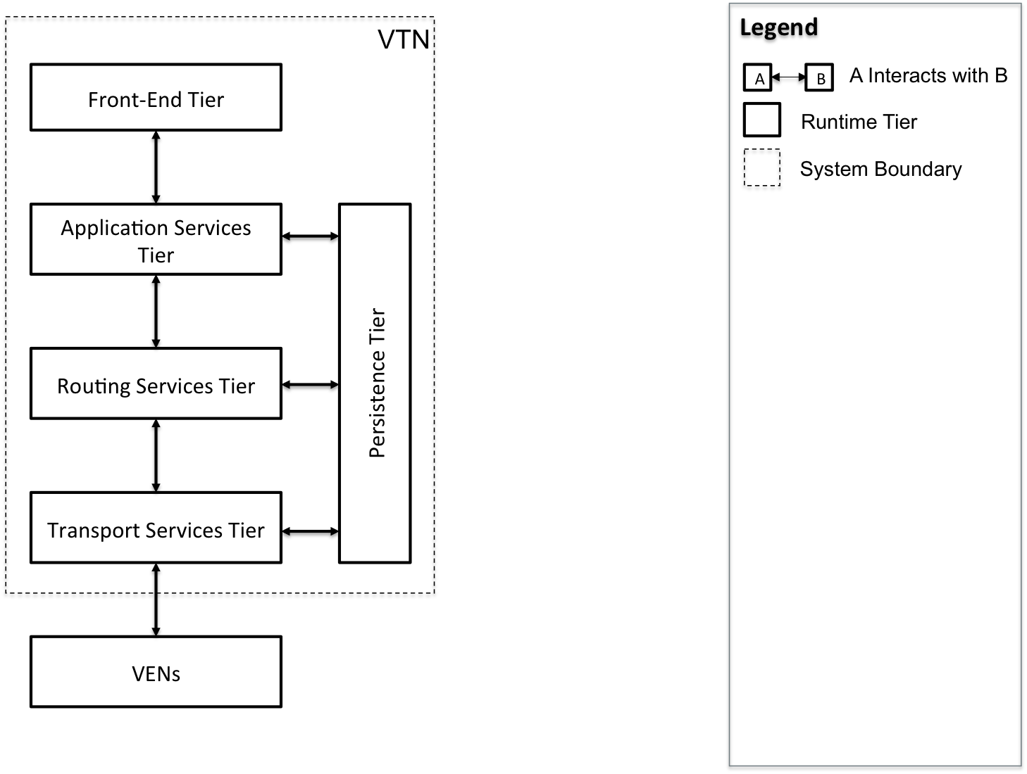
Dynamic Perspective, High-Level Context
Requirements / Design / Management / Quality / Risk

Slide 75
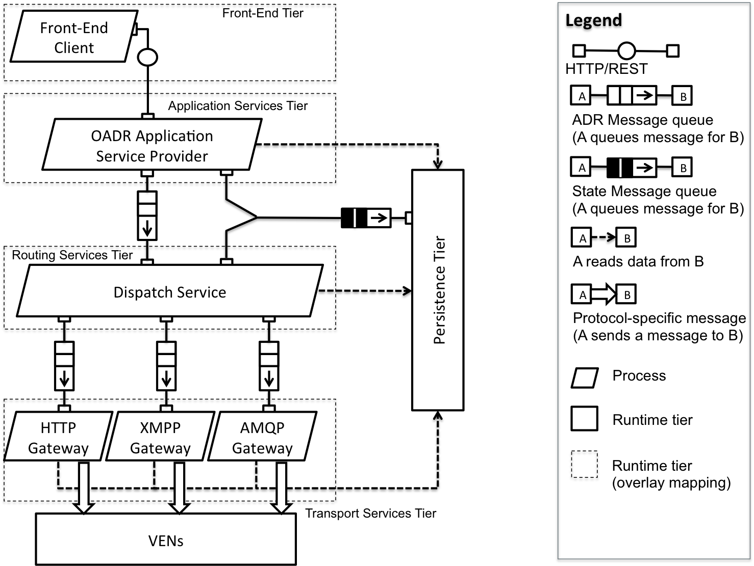
Dynamic Perspective, Outbound Message Flow
Requirements / Design / Management / Quality / Risk

Slide 76
Dynamic Perspective, Outbound Message Flow
Requirements / Design / Management / Quality / Risk

Slide 77
Dynamic Perspective, Outbound Message Flow
Requirements / Design / Management / Quality / Risk

Slide 78
Dynamic Perspective, Outbound Message Flow
Requirements / Design / Management / Quality / Risk

Slide 79
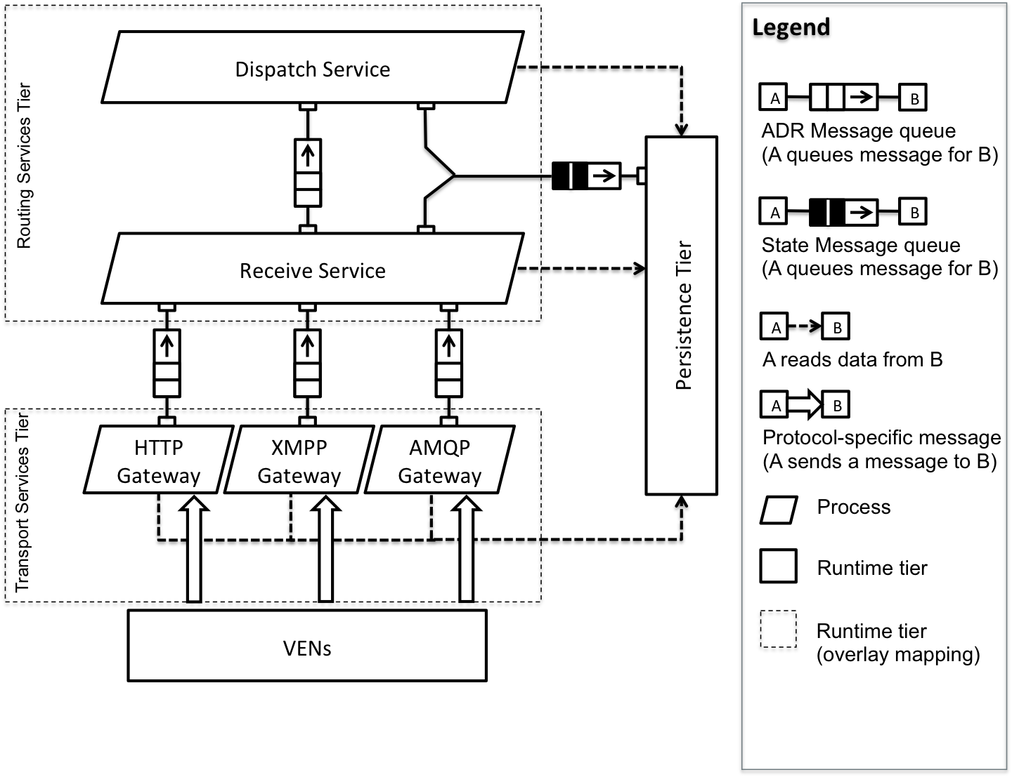
Dynamic Perspective, Inbound Message Flow
Requirements / Design / Management / Quality / Risk

Slide 80
Dynamic Perspective, Inbound Message Flow
Requirements / Design / Management / Quality / Risk

Slide 81
Dynamic Perspective, Inbound Message Flow
Requirements / Design / Management / Quality / Risk

Slide 82
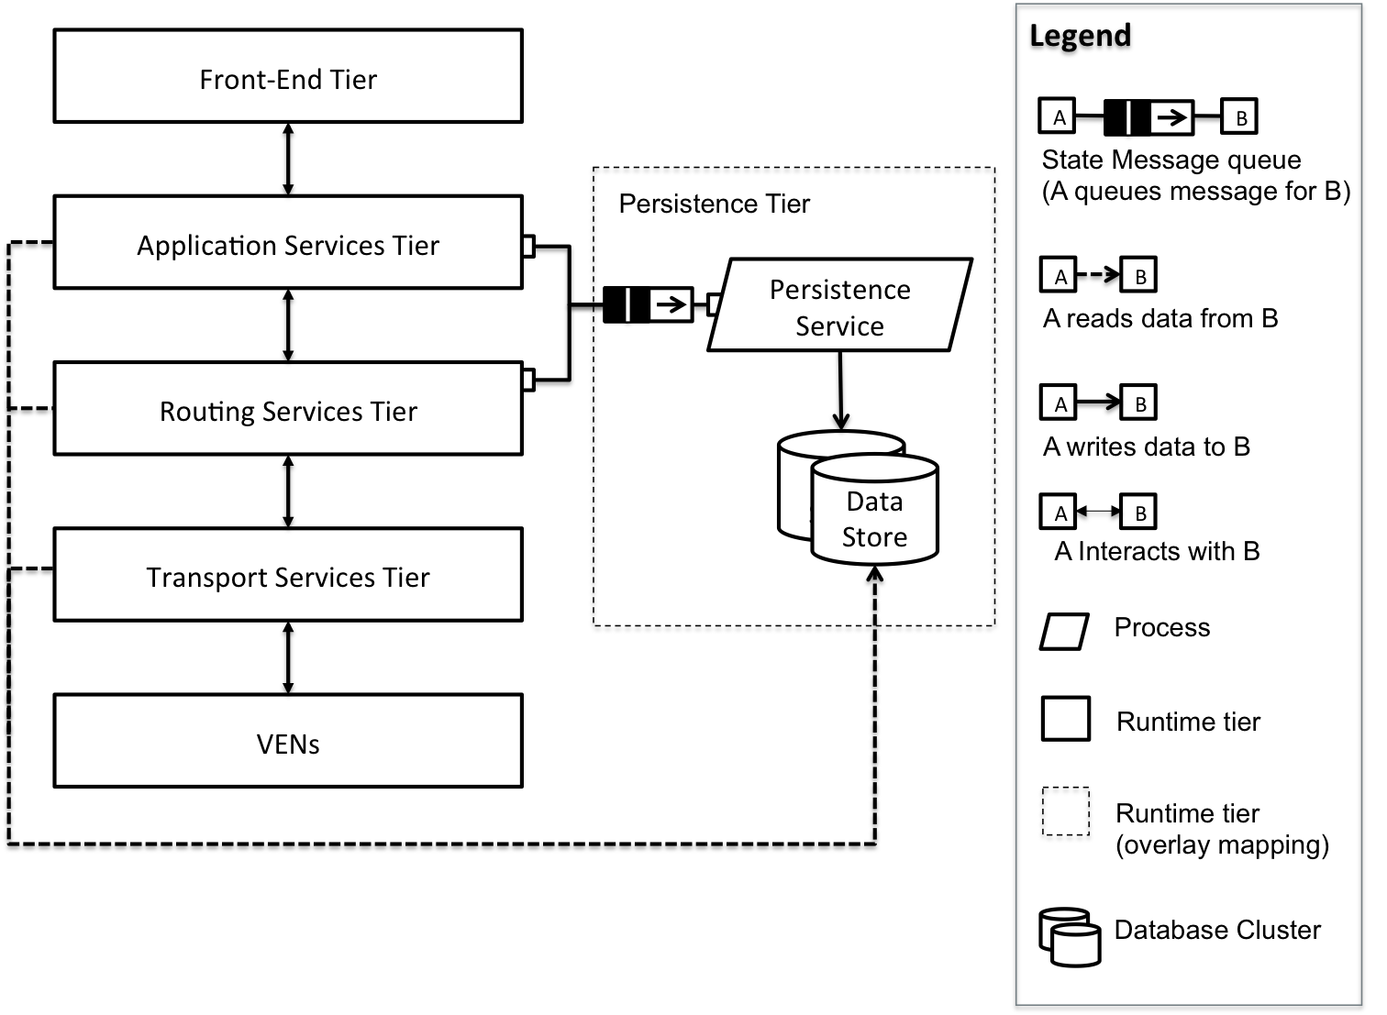
Dynamic Perspective, Persistence Tier
Requirements / Design / Management / Quality / Risk

Slide 83
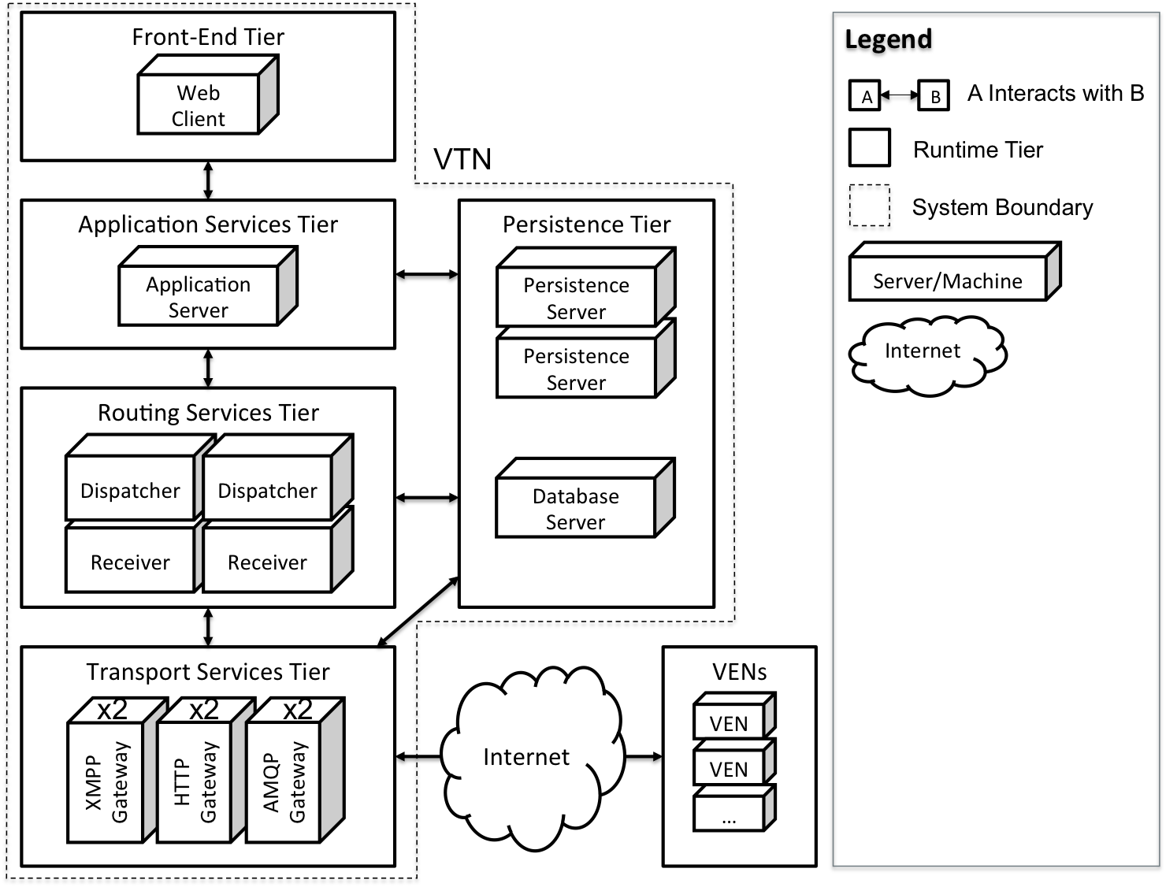
Physical Perspective, Allocation View
Requirements / Design / Management / Quality / Risk

Slide 84
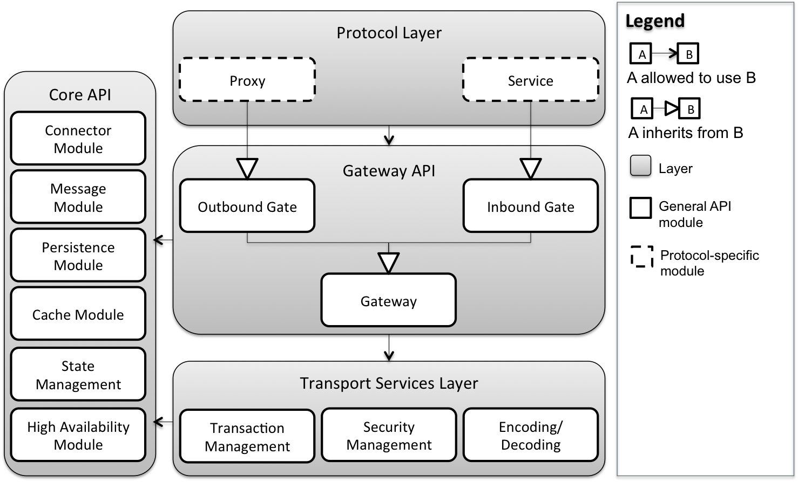
Static Perspective, Protocol Gateway API
Requirements / Design / Management / Quality / Risk

Slide 85
Static Perspective, Protocol Gateway API
Requirements / Design / Management / Quality / Risk

Slide 86
Static Perspective, Protocol Gateway API
Requirements / Design / Management / Quality / Risk

Slide 87
QA01 – Scalability Scenario
QA01 | Scalability
Source of Stimulus | An aggregator increases the size of its DR network
Stimulus | VTN utilization increases; the number of messages exchanged with VENs increases
Environmental Conditions | The VTN is at its peak capacity and serving 50,000 VENs Additional VENs will cause a degradation in response time
Architectural Elements | Routing Services Tier, Persistence Tier, Transport Services Tier
System Response | Additional VENs are added to the network New Dispatcher, Receiver, or Gateway instances are launched
Response Measures | No degradation in performance VTN should maintain 200 message per sec throughput Inbound and outbound messages processed in 500 ms

Slide 88
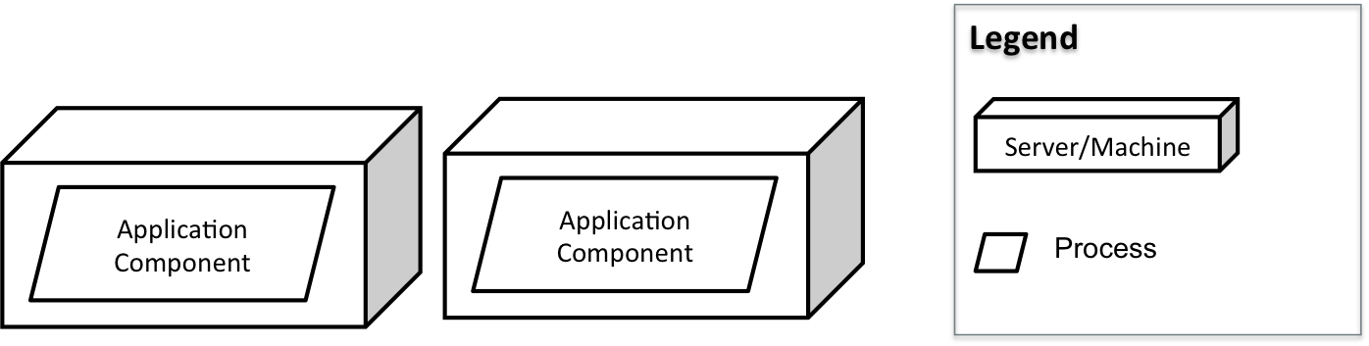
QA01 – Scalability Design Decisions
Redundant hosting of application components with medium size servers

Slide 89
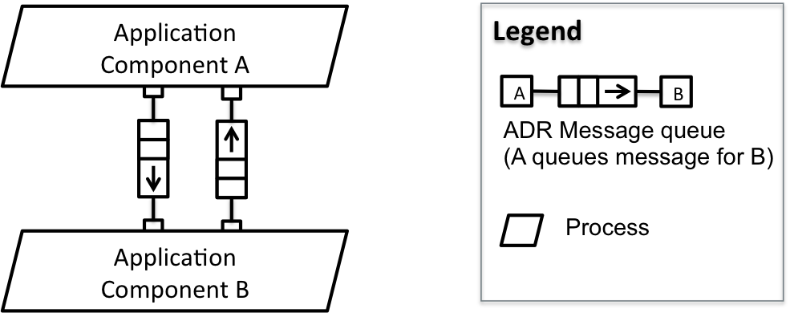
QA01 – Scalability Design Decisions
Event-driven asynchronous communication

Slide 90
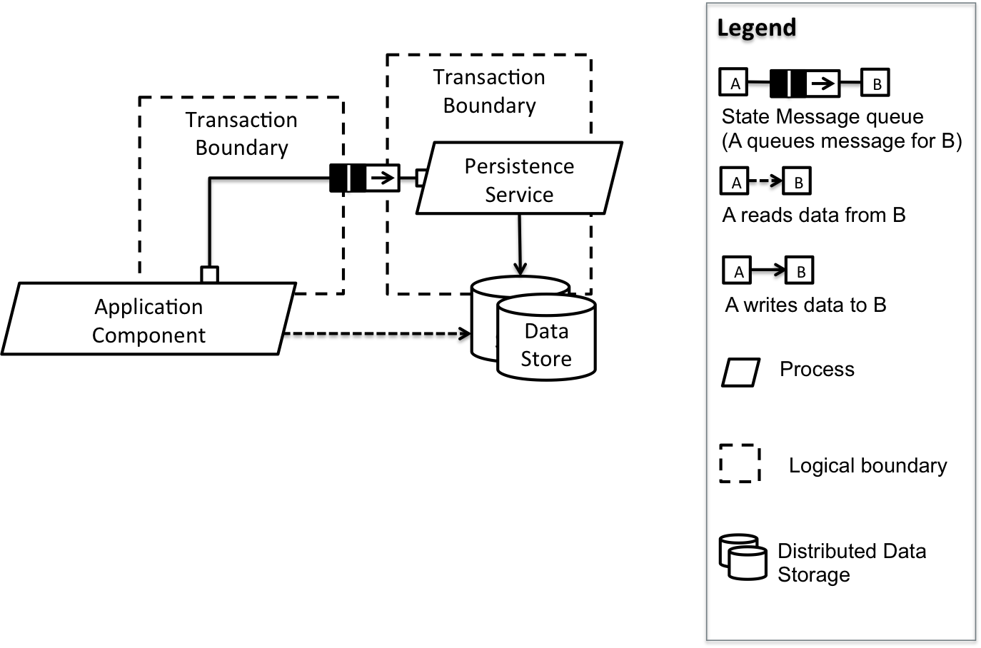
QA01 – Scalability Design Decisions
Command Query Responsibility Segregation (CQRS)
Avoid distributed transactions

Slide 91
Extensibility Scenarios
QA06 Protocol Extensibility: An application vendor wants to support an additional transport protocol. The development effort for complying with the provided interfaces and adding support for a new protocol should not exceed one person-day.
QA07 Service Extensibility: Services defined in the OpenADR 2.0 profile have changed (added, modified, or removed). The development effort for complying with the provided interfaces and adding support for a new service should not exceed one person-day.

Slide 92
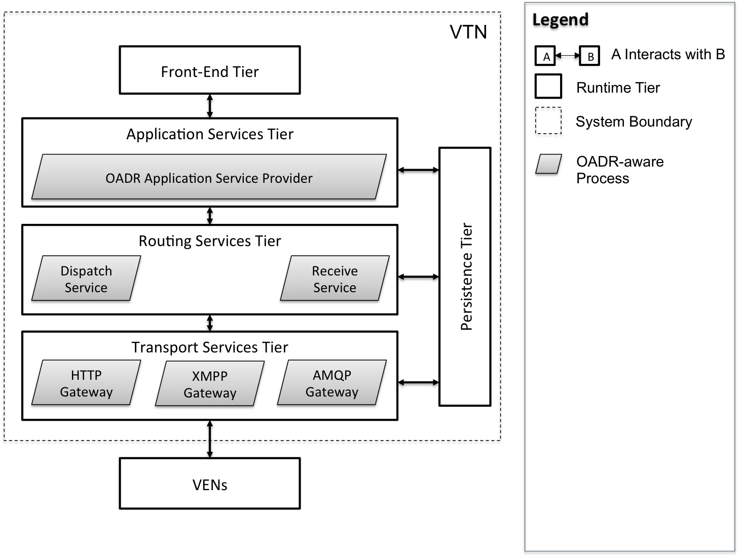
Dynamic Perspective, Process Allocation View

Slide 93
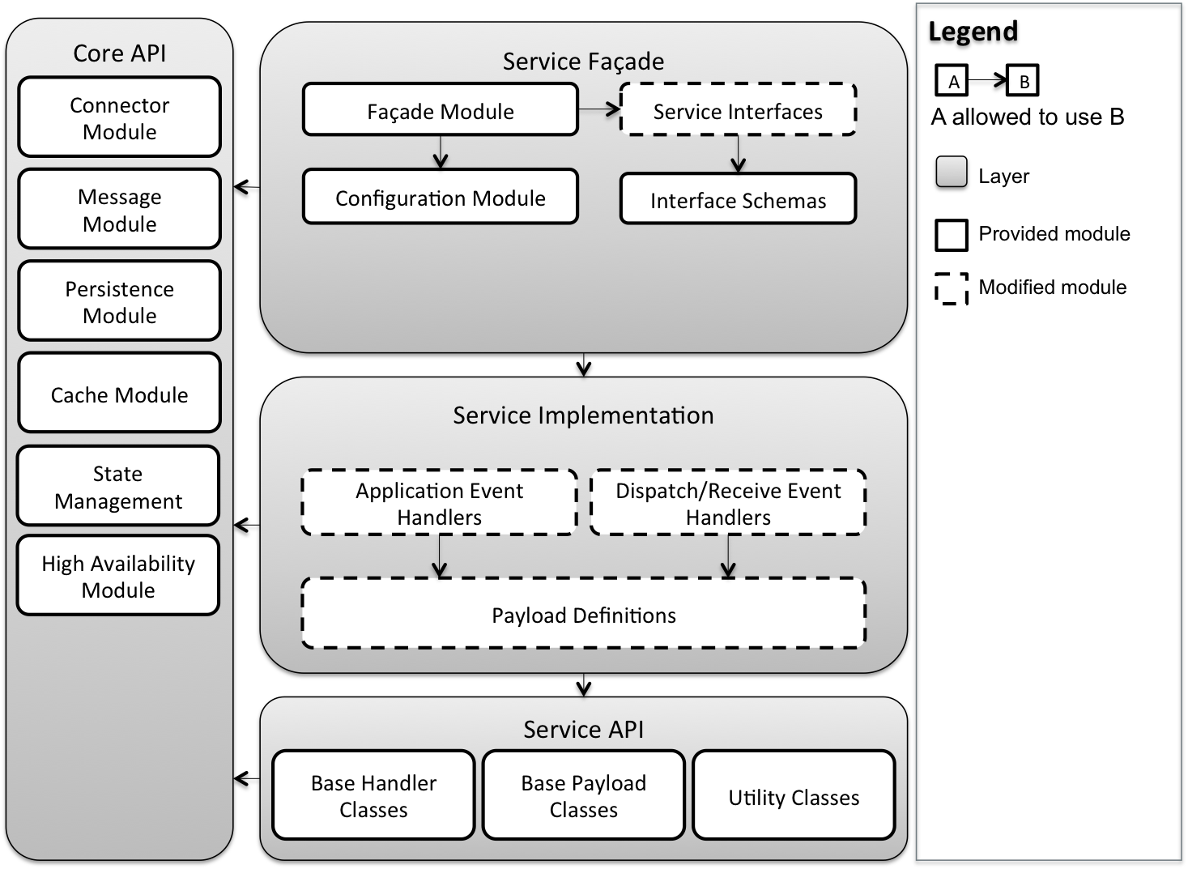
Static Perspective, OpenADR Service API

Slide 94
Performance Quality Attribute Scenarios
QA03 Outbound Latency: Outbound message latency is measured from the time an event is initiated from the Application Services tier to the time it exits the Transport Services tier. For any one message, the total outbound latency should not exceed 500ms.
QA04 Inbound Latency: Inbound message latency is measured from the time a message or request is received by the Transport Services tier to the time it is processed by the Persistence Tier. For any one message, the total inbound latency should not exceed 500ms.
QA05 Throughput: For both inbound and outbound communication paths, the VTN should be able to process 200 messages per second. That is, when distributing events to VENs, the VTN should be able to sustain a burst throughput of 200 messages per second. When receiving asynchronous requests or responses from VENs, the VTN should be able to sustain 200 transactions per second.

Slide 95
Deployability Quality Attribute Scenarios
QA10 Deployability: An administrator, familiar with a public or private cloud infrastructure, should be able to launch a VTN reference implementation and initiate a DR event in less than 20 minutes.

Slide 96
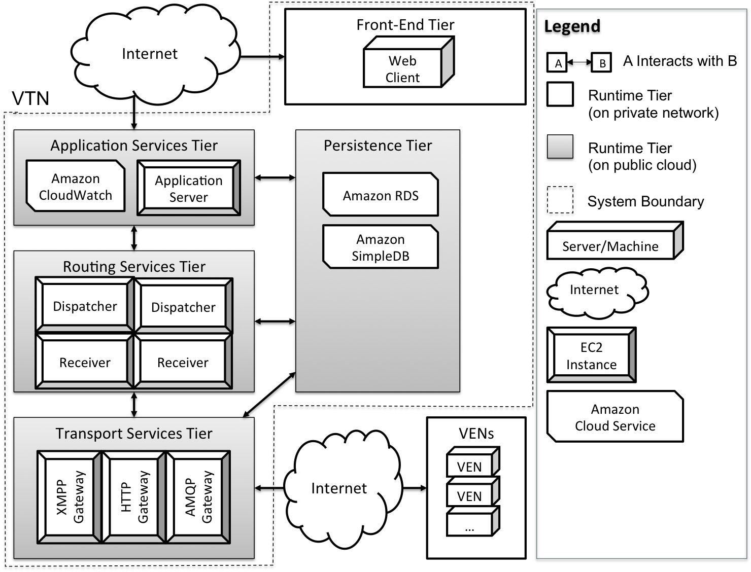
Physical Perspective, Allocation View

Slide 97
Availability Quality Attribute Scenarios
QA14 Fault Detection: A fault occurs; faults have been defined using an appropriate fault model. The VTN detects the fault and notifies systems administrators within one minute using either Email or SMS. Fault information contains sufficient detail such that system administrators can take corrective action.
QA13 Failure Recovery: A failure occurs; failures are traceable to a specific system fault. Manual recovery of any one module can be completed in less than 5 minutes. In the event of failure, no messages are lost in either the outbound or inbound message paths.

Slide 98
Security Quality Attribute Scenarios
QA12 Security: An attacker wishes to disrupt or manipulate a DR network in order to interrupt commercial or industrial operations or potentially damage equipment. The VTN does not respond to any illegitimate requests from unrecognized VENs or rogue applications.

Slide 99
Key Business Constraints
Constraint | Description
Cost Limitation | Fixed budget and schedule for studio project
Schedule Limitation | Incremental delivery
Legal Restriction | No third-party libraries or components Nondisclosure and waiver of intellectual rights
Market Restriction | Simple, understandable design and implementation Supports the OpenADR 2.0 specification Uses industry standard protocols
Logistical Demands | Public cloud infrastructure may be necessary for demonstrating the required scale and performance

Slide 100
Key Technical Constraints
Constraint | Description
Operating System | Target platform should be a Linux flavored operating system Amazon Machine Images (AMI) should support the selected OS
Computing Platform | The system should be verified on Amazon EC2 AMIs
Computer Languages | No usage of proprietary languages resulting in vendor lock-in Preferred computer languages are Java, Ruby or Python
Protocols/Standards | At a minimum, the system should support HTTP (SOAP/REST), XMPP, and an appropriate queuing protocol (e.g., AMQP or STOMP)
Tools/Methods | No proprietary software tools for developing, and testing the system
Computing Capacity | ADR system should support scaling out (scaling horizontally) by adding redundant computing and data storage nodes (servers).

Slide 101
Scenarios for QA: Protocol Extensibility
Source of stimulus | ADR vendors agree to use a new protocol
Stimulus | A software developer is adding support for a new protocol to the system
Environment | The developer is familiar with the relevant documentation and APIs, and the first three protocols are already provided by the reference implementation. The new protocol is based on TCP/IP. Reference architecture is released to the community.
Artifact | VTN
Response | The new protocol is successfully implemented and integrated into the system.
Response measure | Implementation and integration should require no changes to the existing system. Extensibility should be achieved through the existing interfaces.

Slide 102
Scenarios for QA : Service Extensibility
Source of stimulus | OASIS publishes a new version of the Energy Interoperation standard, which specifies new services or operations.
Stimulus | A developer adds a new OpenADR service or operation
Environment | Abstract service interfaces exist to support communication between VTN and VENs
Artifact | VTN
Response | The new service is added to the system.
Response measure | No interface modifications or deletions are required. However, adding new interfaces is permitted.

Slide 103
Scenarios for QA : Scalability
Source of stimulus | The number of messages/unit time increases.
Stimulus | New VTNs are added to the system due to growth of the business
Environment | Assuming each server stack can manage 50,000 VENs for the defined throughput (specified in a SLA), the VTN is now overloaded . However, limitations of underlying technologies may be disregarded.
Artifact | VTN
Response | The server resource is added and configured to handle the load.
Response measure | No software code-level changes are permitted and the required throughput is maintained. However, code changes are acceptable when scaling in order of magnitude (e.g. 10,000 VENs to 1,000,000 VENs).

Slide 104
Scenarios for QA: Performance Outbound latency
Source of stimulus | aggregator wants to send the DR event to end node users
Stimulus | An automated or manual message transfer is initiated
Environment | VEN ready for receive the event
Artifact | VTN
Response | The particular DR event is delivered to each of the intended VENs.
Response measure | Refer to Slow DR profile, Medium DR profile, Real-time DR profile.

Slide 105
Scenarios for QA: Performance Inbound latency
Source of stimulus | 10,000 VENs need to find out if they are intended to receive an event from the VTN
Stimulus | The VENs send messages to the VTN, polling for events. Or responding to events
Environment | VEN can communicate with VTN
Artifact | VTN
Response | Persistence the event from VEN
Response measure | Refer to Slow DR profile, Medium DR profile, Real-time DR profile.

Slide 106
Scenarios for QA: Performance Throughput
Source of stimulus | Messages sent from the VTN to the VENs in the case of a DR event.
Stimulus | An automated or manual message transfer is initiated
Environment | VEN VTN can communicate with each other.
Artifact | VEN,VTN
Response | The particular DR event is delivered to each of the intended VENs. Persistence the event from VEN.
Response measure | At any given time, the VTN system should be able to process 200 messages, both outgoing and incoming. For each message (outgoing or incoming), the processing time should not be more than 200ms .

